Slide 1



10-Minute Magic:
Data-Driven Insights into Blinkit’s Quick Commerce Model

Slide 2
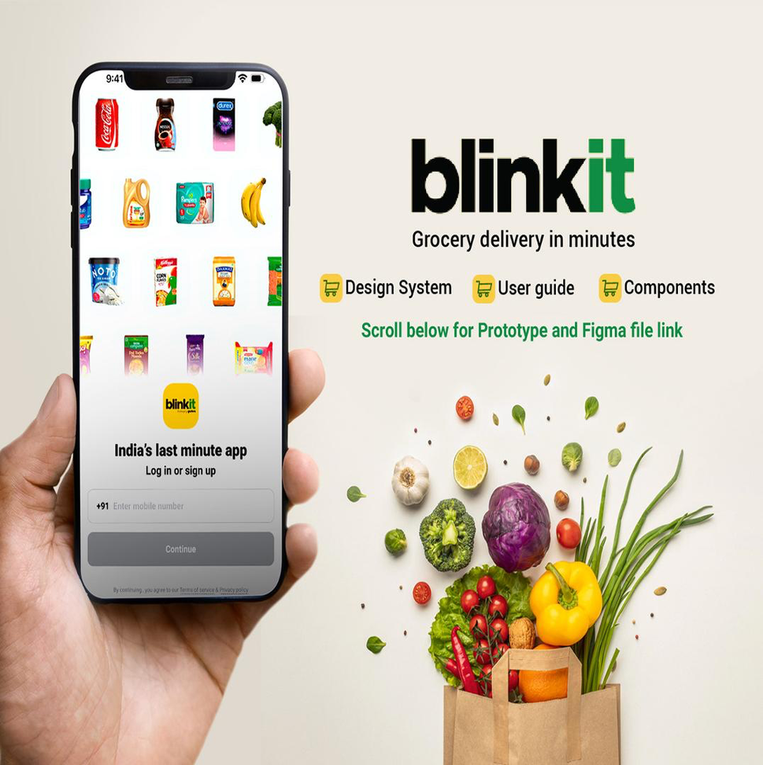
Introduction
Founded in 2013 as Grofers, rebranded to Blinkit in 2021 and acquired by Zomato in 2022.
Delivers groceries and essentials within 10–15 minutes using a hyperlocal dark store model.
Operates 400+ dark stores across 25+ Indian cities, making it a leader in ultra-fast delivery.
Offers a wide range of categories including dairy, snacks, personal care, and groceries.
Known for serving “need-it-now” moments, Blinkit sets new standards in quick commerce.

Slide 3

About the
Dataset
Source: Blinkit Sales Dataset (Kaggle)
Time Period Covered: January 2023 – December 2024
Scope: Urban and semi-urban regions across India (metro and non-metro)
The datasets used span multiple business functions such as customer behavior, order history, delivery efficiency, inventory movement, marketing performance, and product metadata.
Enabled behavioral and operational analysis of Blinkit’s conversion, delivery speed, customer retention, and campaign impact
Formed the foundation for exploring urgency marketing effectiveness, impulse buying trends, and revenue optimization

Slide 4

Motivation
&
Purpose
Motivation:
The demand for instant gratification has redefined customer expectations in e-commerce. Blinkit’s 10–15 minute delivery model leads India’s quick commerce push but brings challenges in logistics, marketing, and customer retention. This project is motivated by the need to understand how urgency campaigns and delivery speed impact user behavior and business performance.
Purpose:
This study aims to uncover insights from Blinkit’s marketing, delivery, and customer data to evaluate how urgency campaigns, delivery speed, and lead times influence conversions, impulse purchases, and customer retention—guiding strategies for growth and efficiency in quick commerce.

Slide 5

What We Aim to
Deliver
Goal:
To assess how Blinkit’s marketing strategies, delivery speed, and operational efficiency influence customer behavior and business outcomes in the quick commerce space.
Objectives:
Evaluate the effectiveness of urgency-based marketing campaigns (e.g., flash sales) in converting users with a history of abandoned carts.
Analyze the impact of ultra-fast delivery on impulse buying behavior, order frequency, and average basket size over time.
Measure how delivery lead time affects customer lifetime value (CLV), repeat purchases, and revenue per user across various geographic segments.

Slide 6
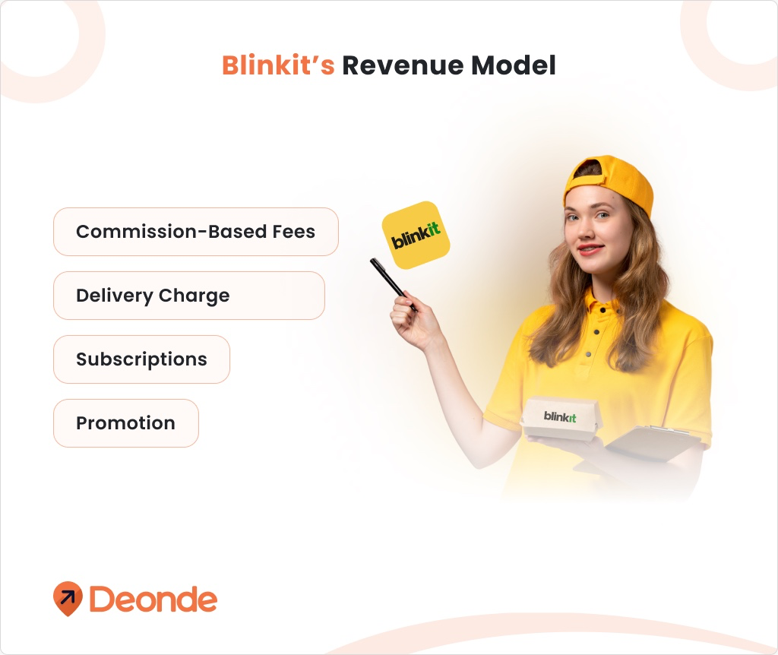
Peer Review
Feedback
Process
Feedback was gathered through formal peer reviews in class and by sharing visual snapshots.
The goal was to assess clarity, alignment with research questions, and storytelling strength.
Key Comments Received
Visualizations were visually strong, but initially did not directly answer the research questions.
Stacked bar and line charts lacked clear conclusions, especially regarding abandoned carts and sentiment patterns.
Peer reviewers emphasized better alignment between charts and narrative structure.

Slide 7

Implementation of Feedback
Reframed dashboards to directly address each sub-question, ensuring one-to-one alignment between visuals and insights.
Added cart abandoner segmentation, lead time-churn overlays, and impulse trendlines based on peer critiques.
Removed unrelated elements (e.g., stock-outs) and replaced them with visuals like product category impact on fast delivery.
Enhanced storytelling clarity by using Mattison’s framework—starting with insight, then showing supporting visuals.

Slide 8
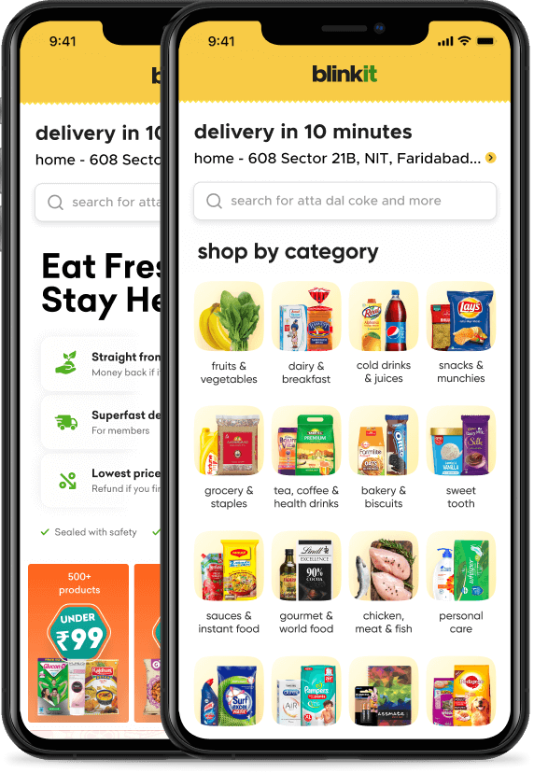
Visualizations

Slide 9
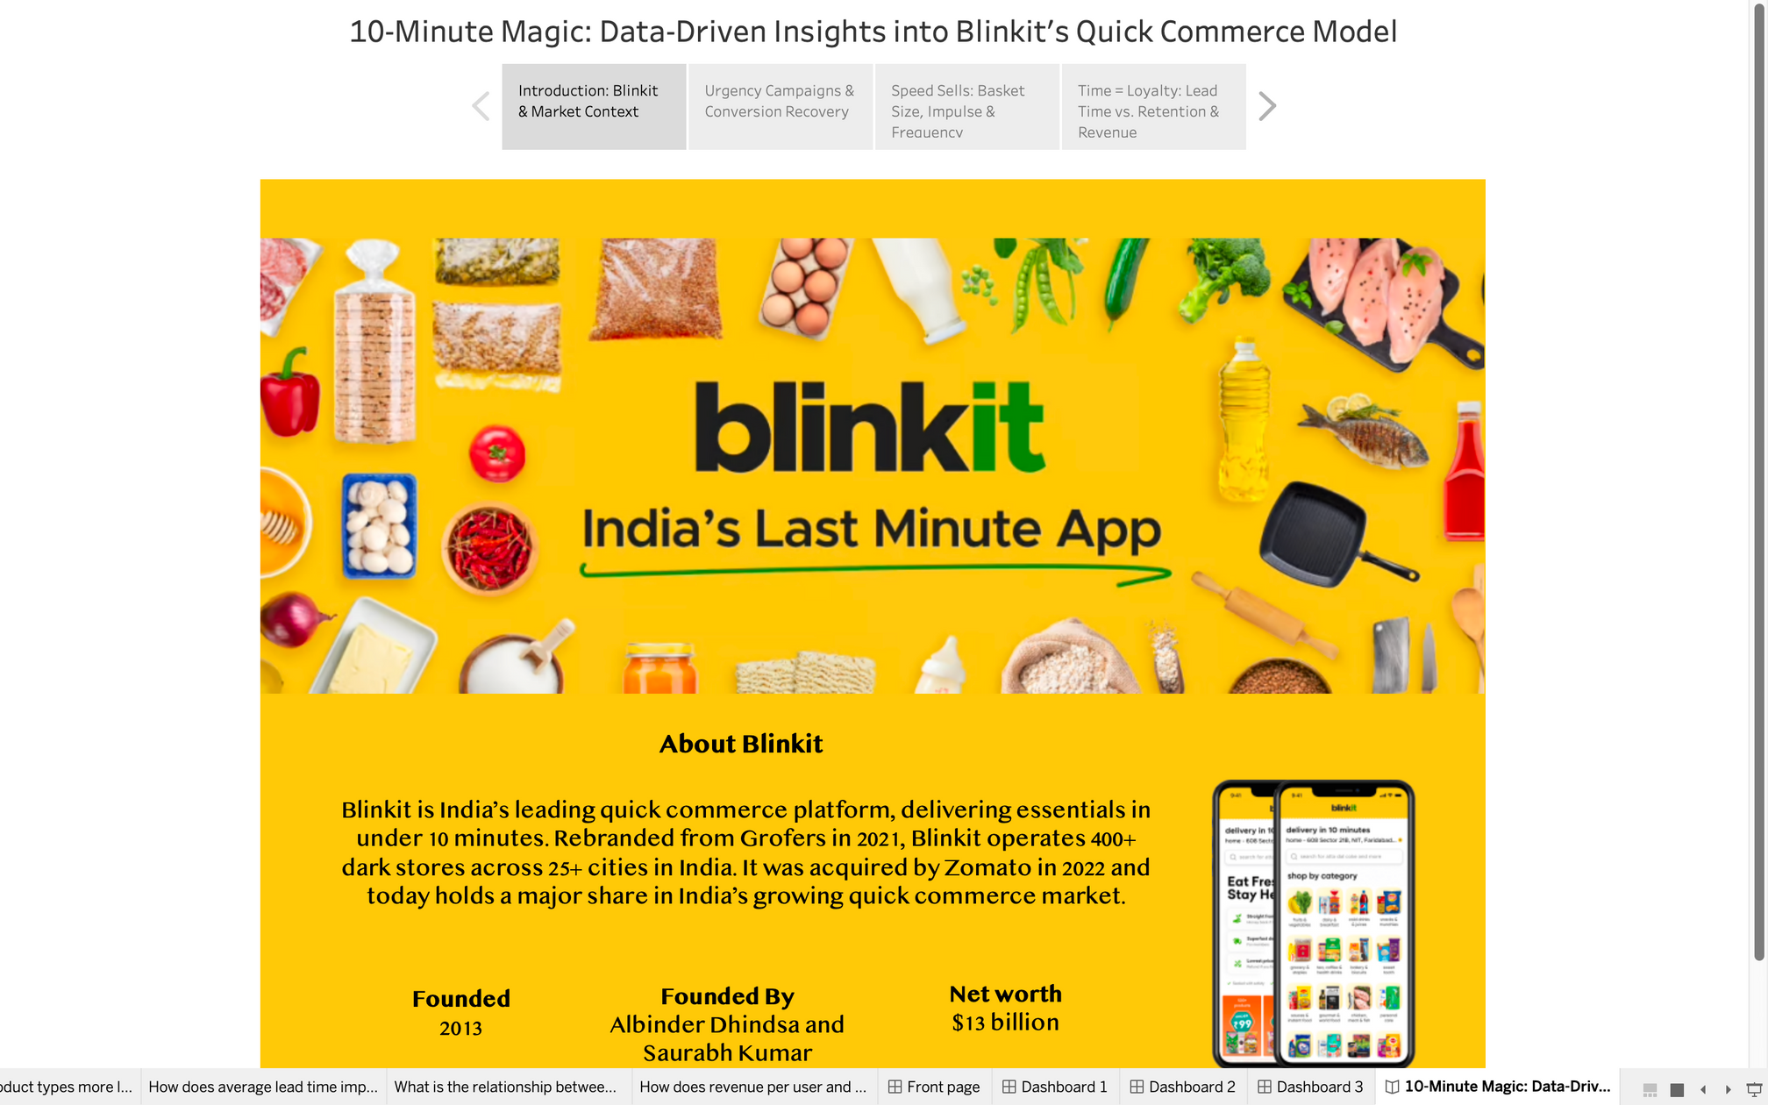

Slide 10
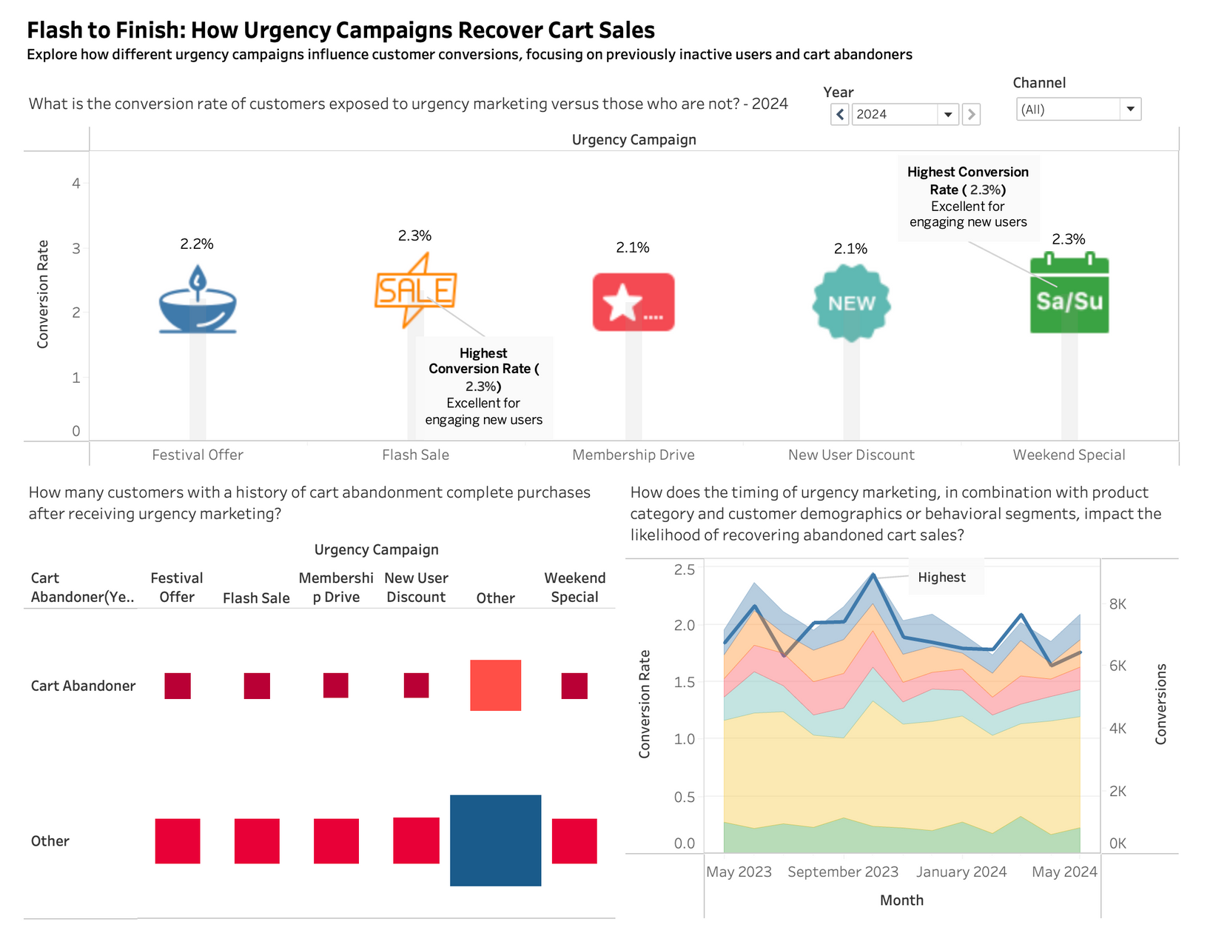

Slide 11
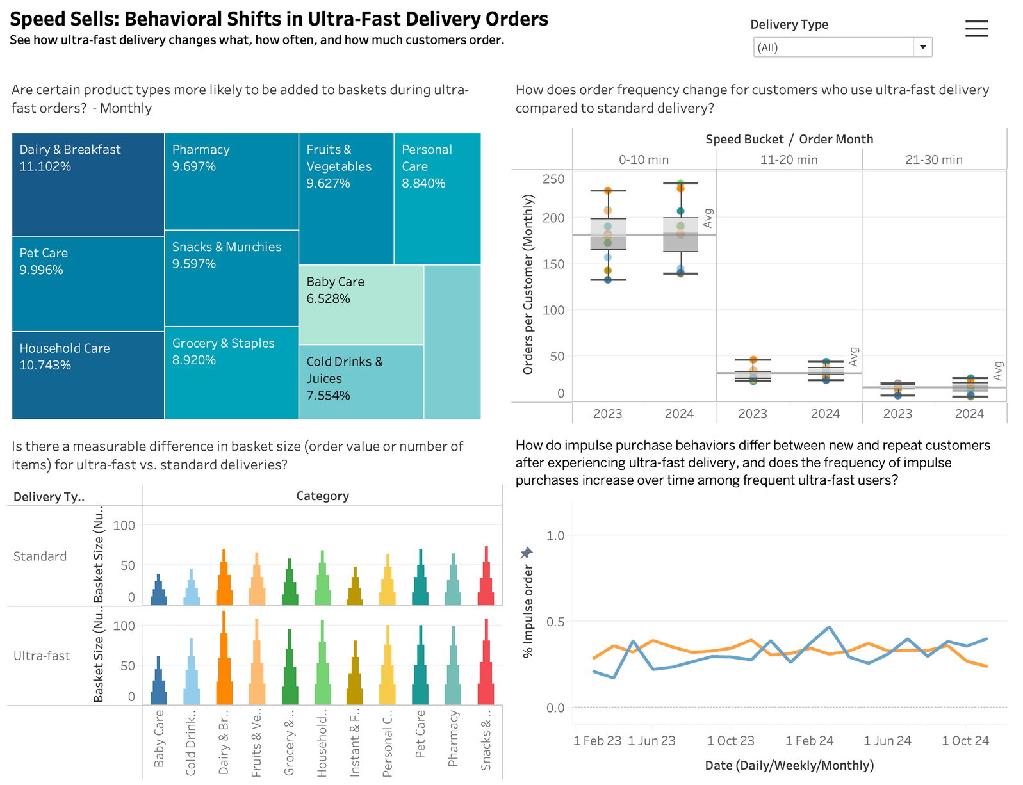

Slide 12
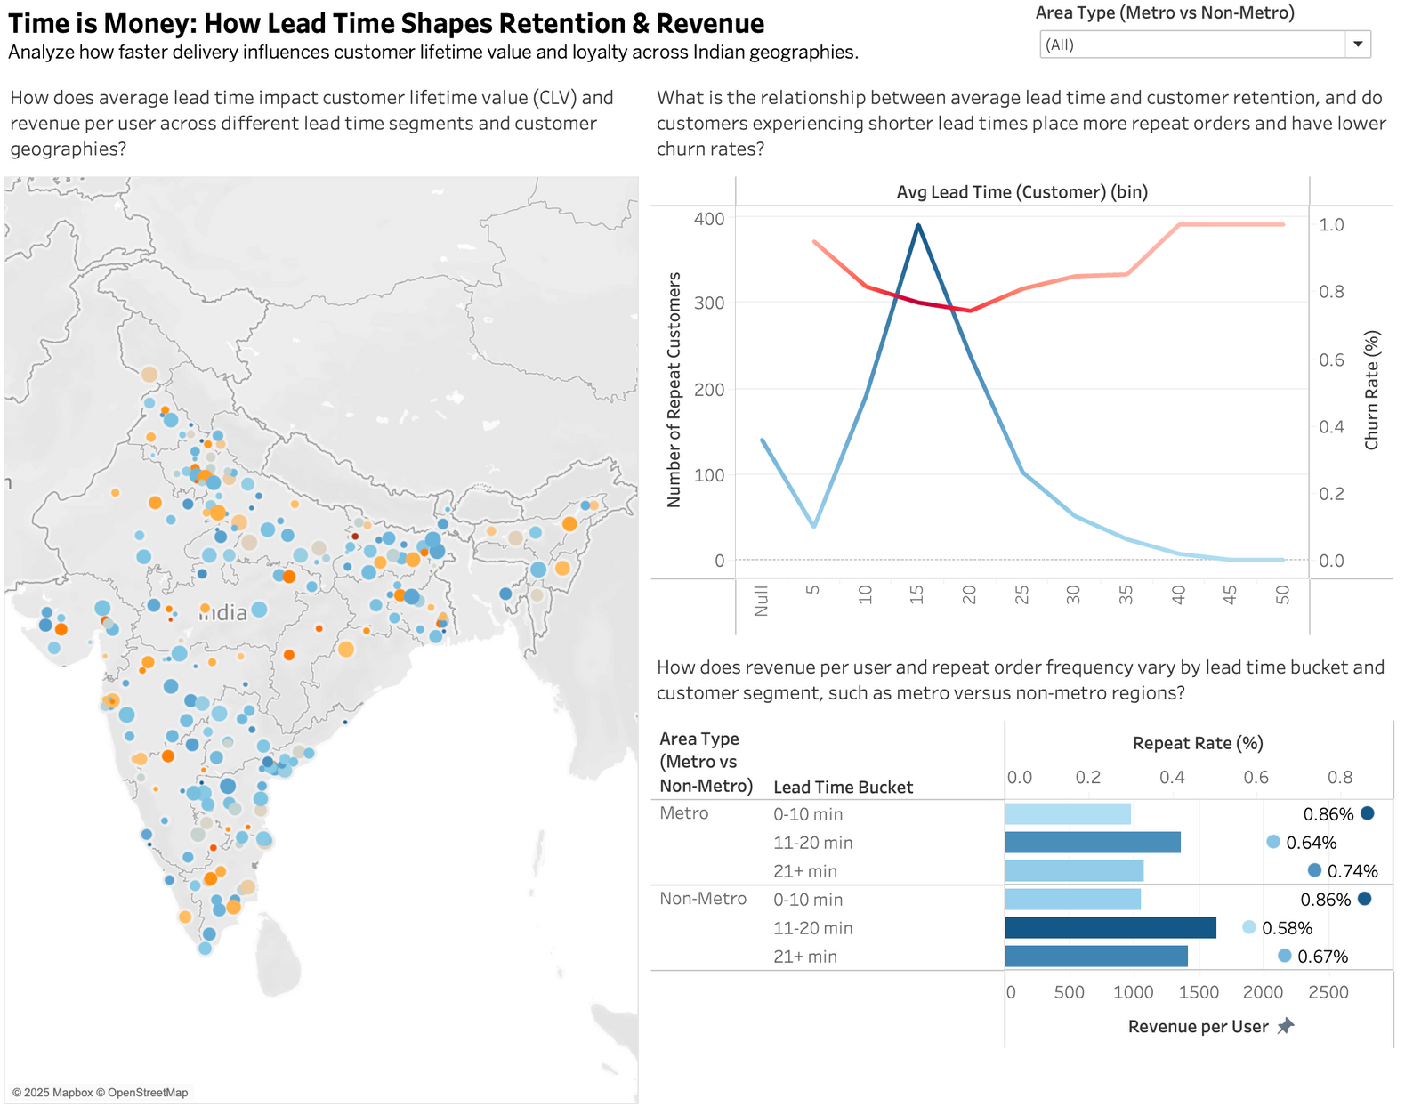

Slide 13

Key Findings:
Urgency campaigns like flash sales increased conversions among cart abandoners (up to 2.3%).
Ultra-fast delivery led to more frequent orders, larger baskets, and higher impulse buying.
Shorter lead times (<15 mins) improved retention, repeat rates, and revenue per user.
Metro regions showed the strongest response, but non-metro areas also showed potential.
Design Principles:
Used Tufte’s data-ink ratio to minimize clutter and highlight insights.
Applied Knaflic’s storytelling method—each chart answered a specific research question.
Peer feedback led to better chart labeling, cleaner layouts, and clearer audience targeting.

Slide 14

Conclusion
This project met all revised objectives by showing that urgency marketing improves cart recovery, ultra-fast delivery boosts impulse purchases, and shorter lead times increase customer retention and revenue per user. These insights provide valuable direction for optimizing Blinkit’s marketing and delivery strategies. Limitations included missing real-time data and incomplete campaign tracking, which affected deeper analysis. Future work could explore AI-based routing and real-time personalization to further enhance quick commerce performance.

Slide 15





Thank
You

